Slide 1
BLG252E-OBJECT ORIENTED Programming
Practice Assignment 1

Slide 2
A parabola class
Make a class defining a polynomial of second degree
y = Ax² + Bx + C
The coefficients A, B, C should be private. The class should contain a constructor that sets the coefficients to desired values and the following member functions:
a function that calculates and return y for a given value of x
a function that tells how many roots there are and prints the roots on the screen(if any)
a function that tells whether the polynomial has a maximum, a minimum, or no extremum, and gives x and y for the extremum (if any)

Slide 3
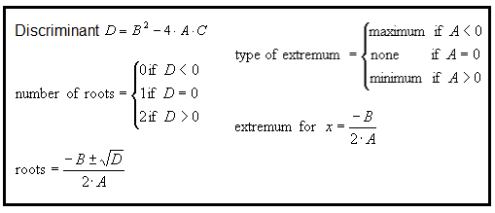
A parabola class
Necessary Formulas:

Slide 4
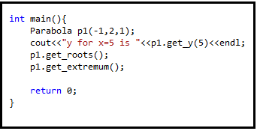
A parabola class
Example test program:

